Slide 1
What You Need to Know About Hemodialysis Water
Presented by Brian Rha, MD, MSPH & Shannon Novosad, MD, MPH

Slide 2
Learning objectives
Identify high-risk areas for contamination in the hemodialysis treatment area.
Describe techniques and practices to avoid contamination.
Enumerate infection prevention strategies for sinks, med prep areas, and maintenance of wall boxes and prime buckets.
Utilize resources such as audit tools and checklists from CDC.

Slide 3
overview
Water used to perform dialysis must be safe and clean.
Hemodialysis patients are exposed to 300-600 liters of water per week
Standards for dialysis water are higher than those for drinking water, but poor water quality can lead to adverse patient outcomes
  outbreaks associated with water exposure in dialysis settings
Notes:
During an average week of hemodialysis, a patient can be exposed to 300-600 liters of water, providing multiple opportunities for potential exposure to waterborne pathogens. For the health and safety of hemodialysis patients, it is vital to ensure the water used to perform dialysis is safe and clean

Slide 4
Water quality recommendations
Guidelines for Environmental Infection Control in Health-Care Facilities (MMWR June 6, 2003)
  CDC and Healthcare Infection Control Practices Advisory Committee (HICPAC)
  General Recommendation Topics:
  Adherence to current AAMI water standards
  Microbiological and bacteriologic testing of dialysis water
  Routine disinfection of dialysis water distribution systems
https://www.cdc.gov/mmwr/PDF/rr/rr5210.pdf
https://www.cdc.gov/dialysis/guidelines/water-use.html
Notes:
The CDC and HICPAC focus on these general topics when it comes to water quality guidelines for dialysis

Slide 5
AAMI Water standards
Association for the Advancement of Medical Instrumentation (AAMI)
Details standards of water usage in dialysis such as:
Equipment and processes used to purify water for preparation of concentrates and dialysate; the reprocessing of dialyzers for multiple use.
The devices used to store and distribute this water.
The allowable and action threshold levels of water contaminants, bacterial cell counts, and endotoxins.
Since AAMI standards have changed over the years, facilities may follow different sets of standards depending on what year they began performing dialysis.
https://www.cdc.gov/mmwr/PDF/rr/rr5210.pdf
https://www.cdc.gov/dialysis/guidelines/water-use.html
Notes:
We can do this by adhering to AAMI guidelines, which details standards of water usage in dialysis such as: READ slide

Slide 6
Bacterial and endotoxin testing
The entire water system require bacteria and endotoxin monitoring at least once a month (or more often if problems occur), with samples from:
RO system (source)
Distribution/delivery system (beginning and end)
Mixing systems (acidified and bicarbonate solutions)
Point of use (dialysis machines)
Monthly testing of representative sample of dialysis machines.
Notes:
The entire water system like the RO, distribution and mixing systems and dialysis machine need to be tested at least monthly.

Slide 7
Water report
what to review
how to interpret
Request the water report: results of routine monthly water and dialysate testing, including endotoxin and bacterial colony counts.
How often is the system disinfected?
Which AAMI standards are they following?
  Action levels are important!
  May be different depending on year
  https://www.cdc.gov/dialysis/guidelines/water-use.html
Focus on actions levels and results outside of parameters.
  Do NOT accept “positive” or “no growth” as a result
  Want a full count of every viable colony
Look for trends.
  Watch for consistent zeros; often see issues arising
Did disinfection increase? Why?
Consider machine-specific results
Notes:
When doing tracers, ask for the water report. Note that each facility may follow different AAMI standards based on the year they began dialysis. READ slides

Slide 8
High risk areas for contamination
Notes:
There are multiple potential areas for water contamination within the outpatient dialysis facility. Therefore multiple outbreaks have been reported.

Slide 9
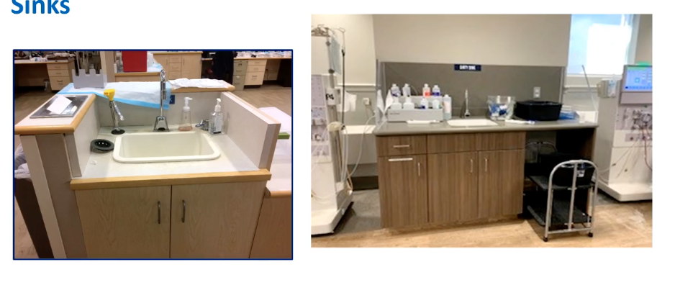
sinks
Notes:
A typical dialysis unit can have multiple sinks. Locations can vary given unit spacing. It’s common for sinks to be close to supplies, medprep areas, and the patient station. Water-associated pathogens and biofilm build up in pipes and become difficult to remove. When water splashes, it leads to dissemination of droplets that can contaminate surrounding areas.

Slide 10
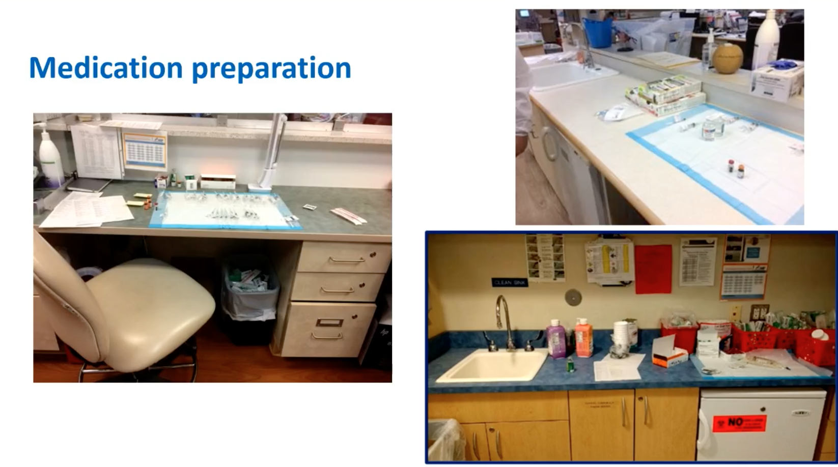
Medication preparation
Notes:
One such area is med prep. Ideally it should be in a designated clean room separate from patient stations. But many outpatient facilities only have a designated counter or area for med prep. On the right, these two prep areas are very close to sinks (WITHIN THE SPLASH ZONE) so supplies can be contaminated.

Slide 11
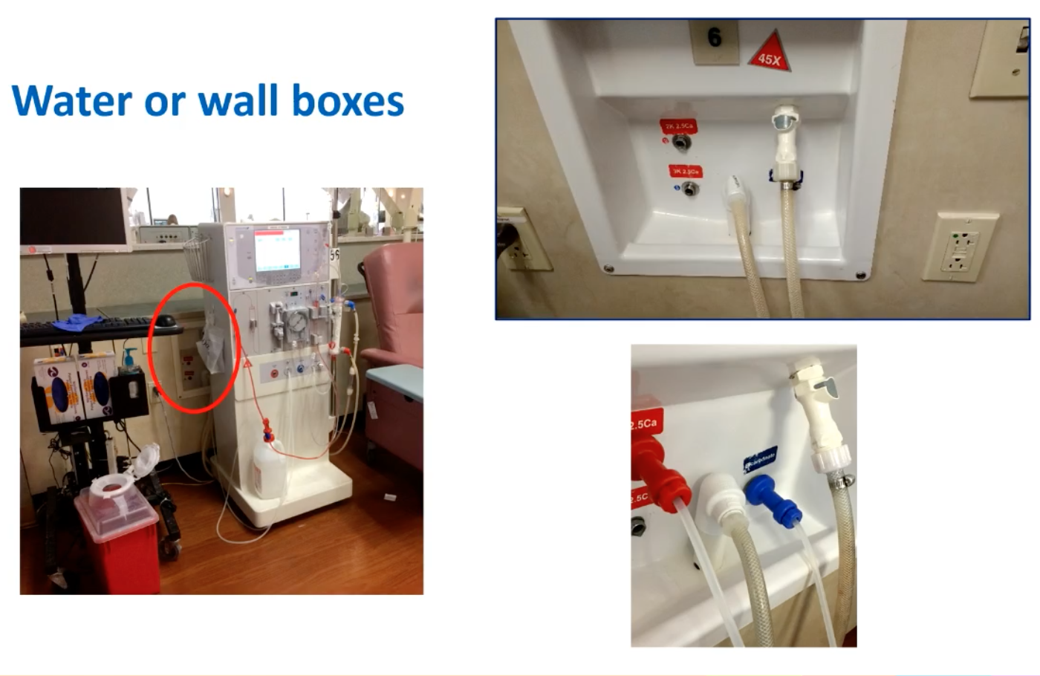
Water/wall boxes
Notes:
Dialysis wall boxes are frames recessed into the wall at each hemodialysis station that contain connections for the dialysis machine to receive acid and base concentrates and treated water and dispose of waste products.
There are several infection prevention and control issues unique to wall boxes. Wall box drains can become clogged, and splashing and foaming at the wall box may occur.
Circled in red is a wall box that is very close to the workstation. This means that the patient is in the splash or spray zone, so he or she is at risk of being contaminated by the microorganisms in the wall box.
Each facility should develop policies about the specific frequency and methods for wall box surface disinfection. It should be disinfected at least daily after all the patients have dialyzed, not during patient care activities. Circled in red is an example of a wall box

Slide 12
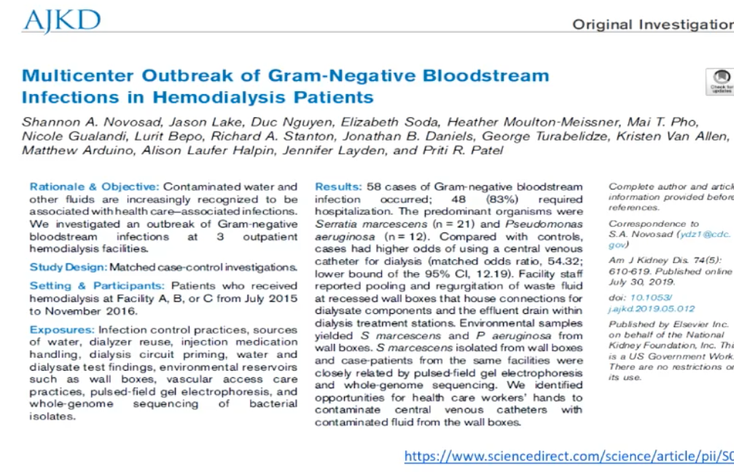
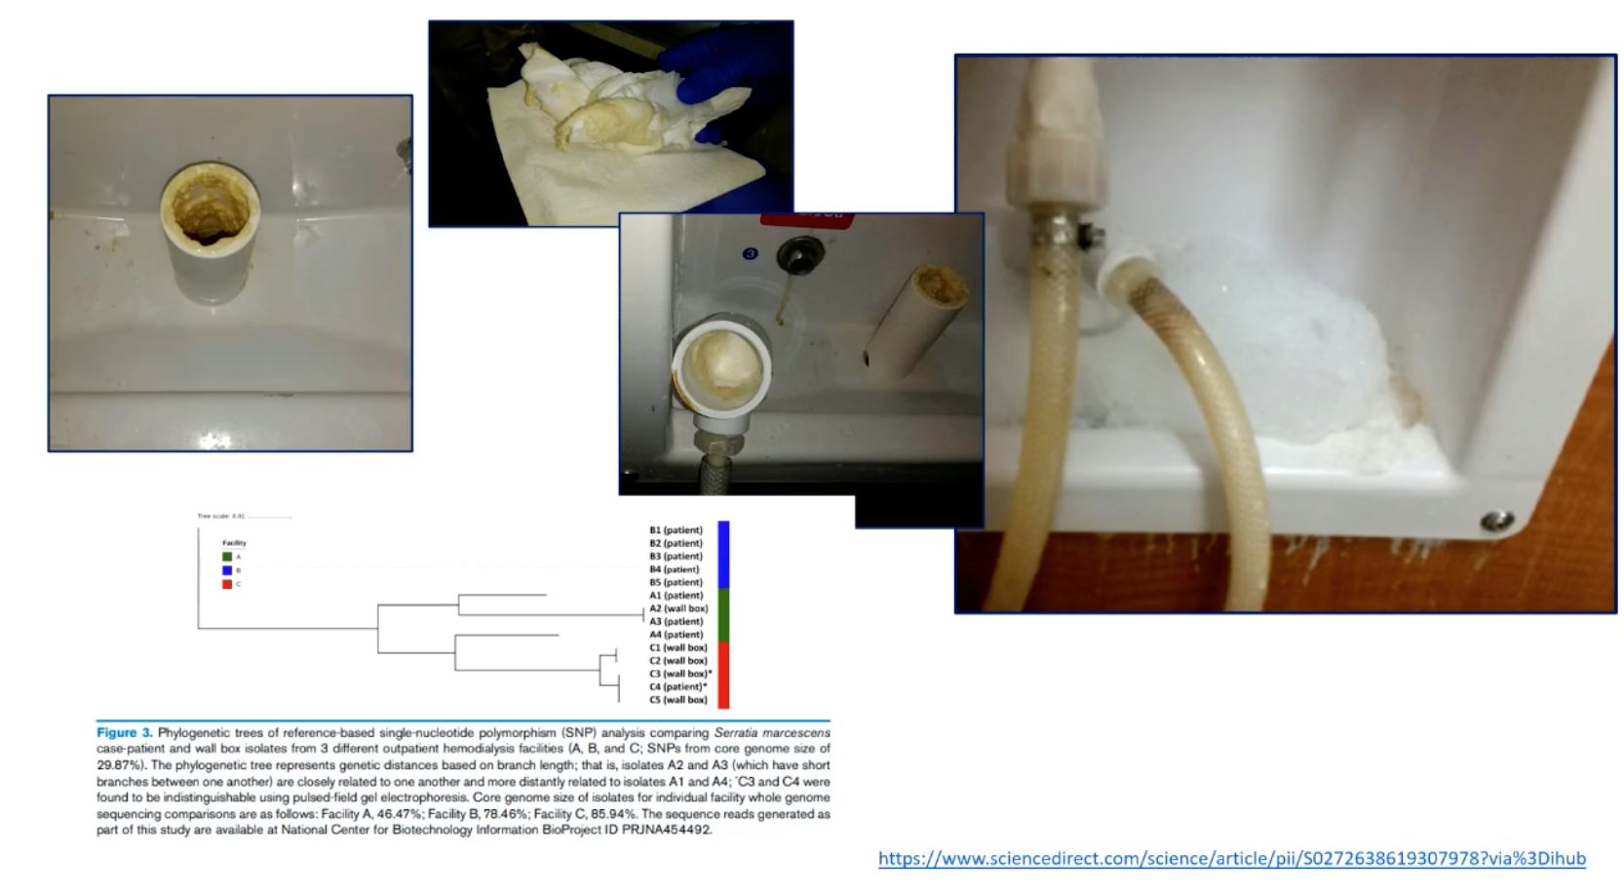
Notes:
There was a large outbreak of more than 50 cases across 3 facilities under the same organization. The predominant microorganisms were Serratia and pseudomonas. Facility staff reported pooling and regurgitation of waste fluid at wall boxes, which you can see on the right. The investigation team also observed breaches in hand hygiene. Because wall boxes are not widely observed areas in outpatient facilities, it is important for wall boxes to be cleaned, disinfected, and properly maintained to decrease risk of patient infections.

Slide 13
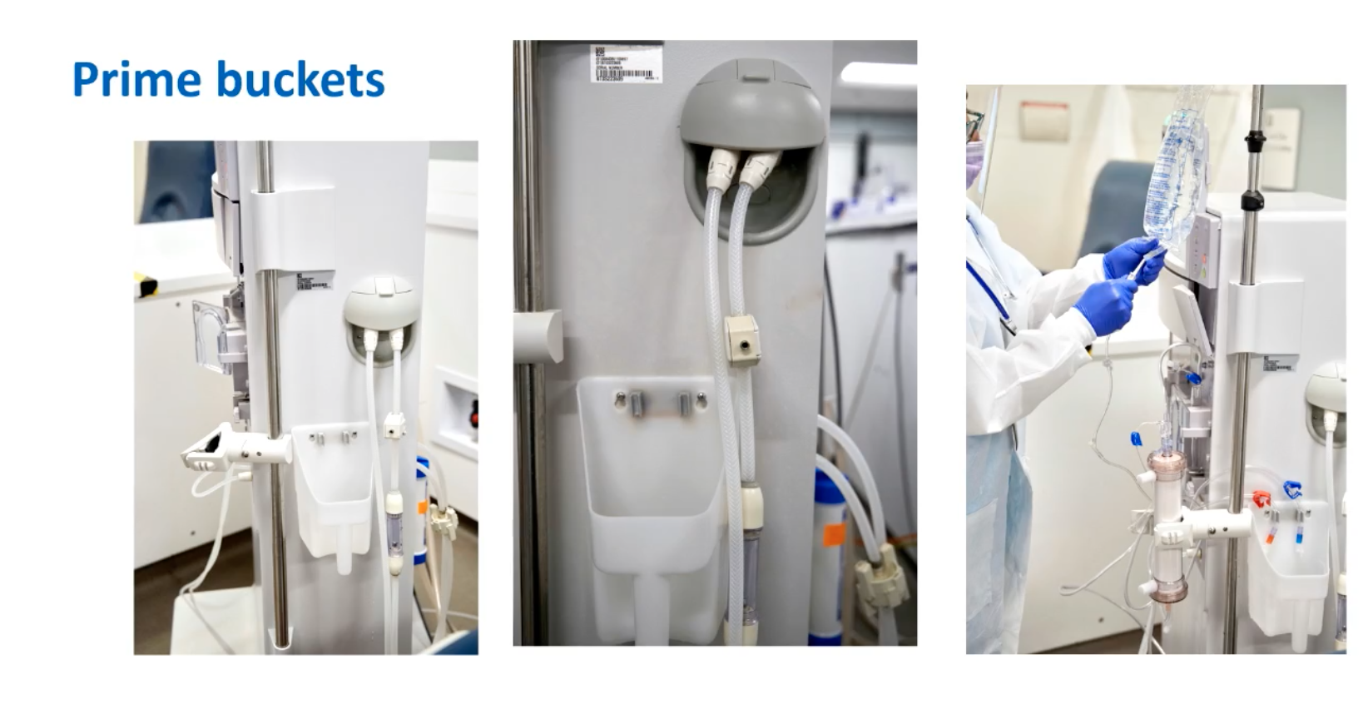
Prime buckets
Notes:
Prime buckets are plastic buckets at the side of dialysis machines which collect excess saline used to prime lines and the dialyzer before someone starts dialysis. It should be cleaned in between patients. Numerous outbreaks have been associated with breaches and inadequate cleaning.

Slide 14
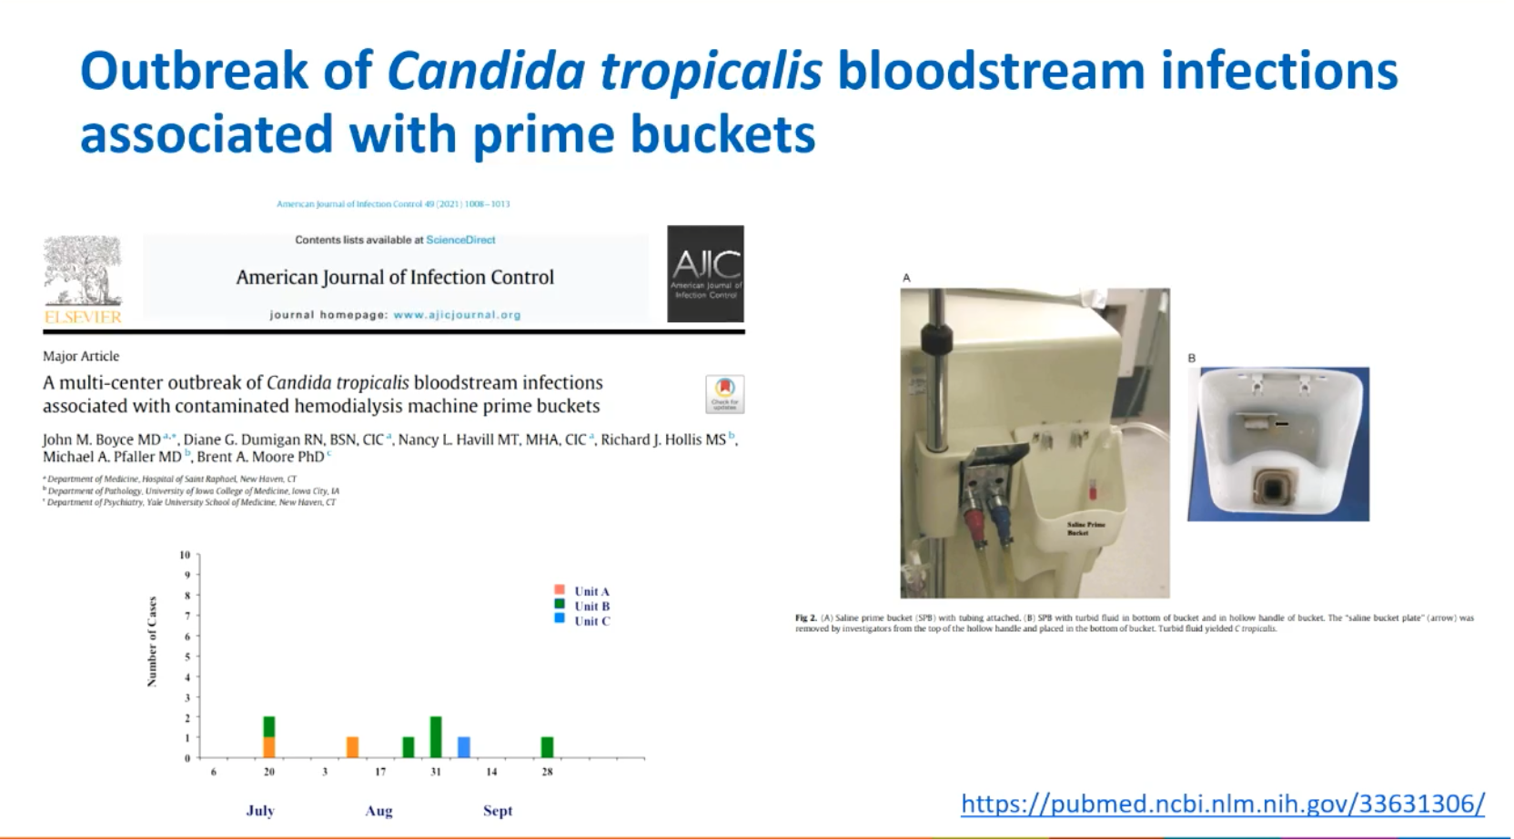
Notes:
There was an outbreak of 8 patients associated with improper disinfection of prime buckets. Visible issues were identified. They were using tap water and returning the buckets to the machines rather than using hospital-approved disinfectant. Disinfection was sporadic and not routine. They also saw discolored fluid inside the hollow handles of prime buckets. Occasionally, staff left the machine tubing draped on the bucket leading to contamination.

Slide 15
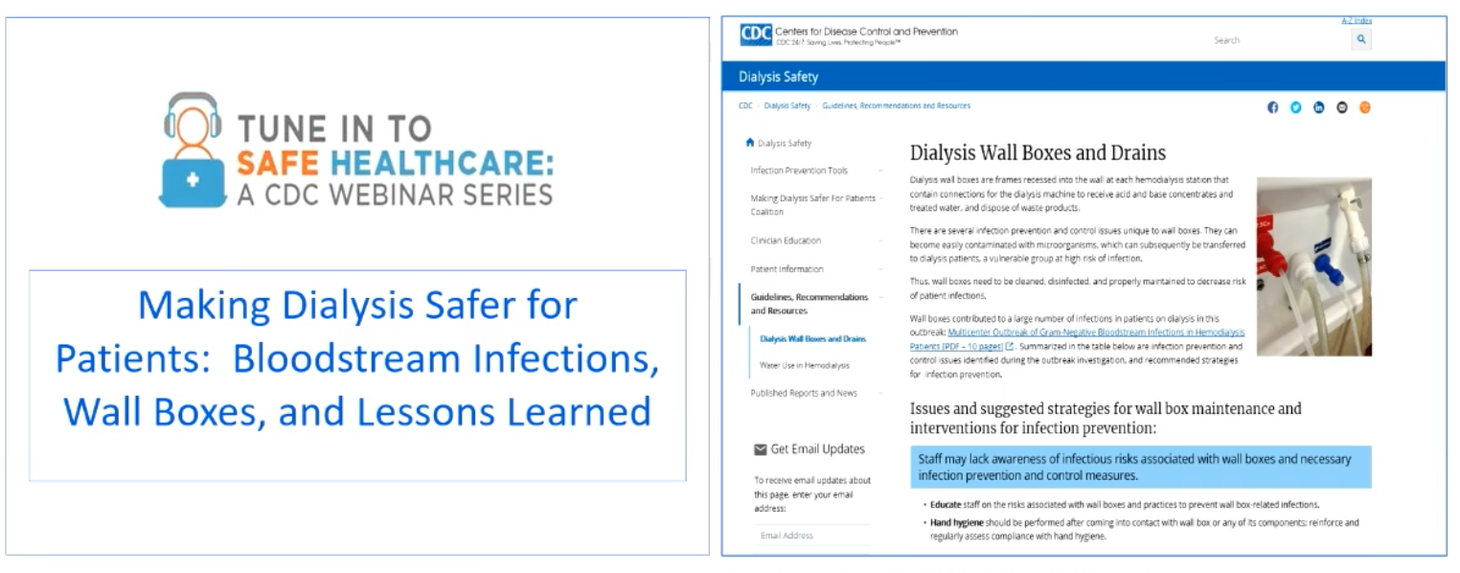
https://www.cdc.gov/infectioncontrol/training/safe-healthcare-webinars.html https://www.cdc.gov/dialysis/guidelines/wall-boxes.html
Notes:
If you want to learn more, here are two resources with the links below for hemodialysis safety guidelines.

Slide 16
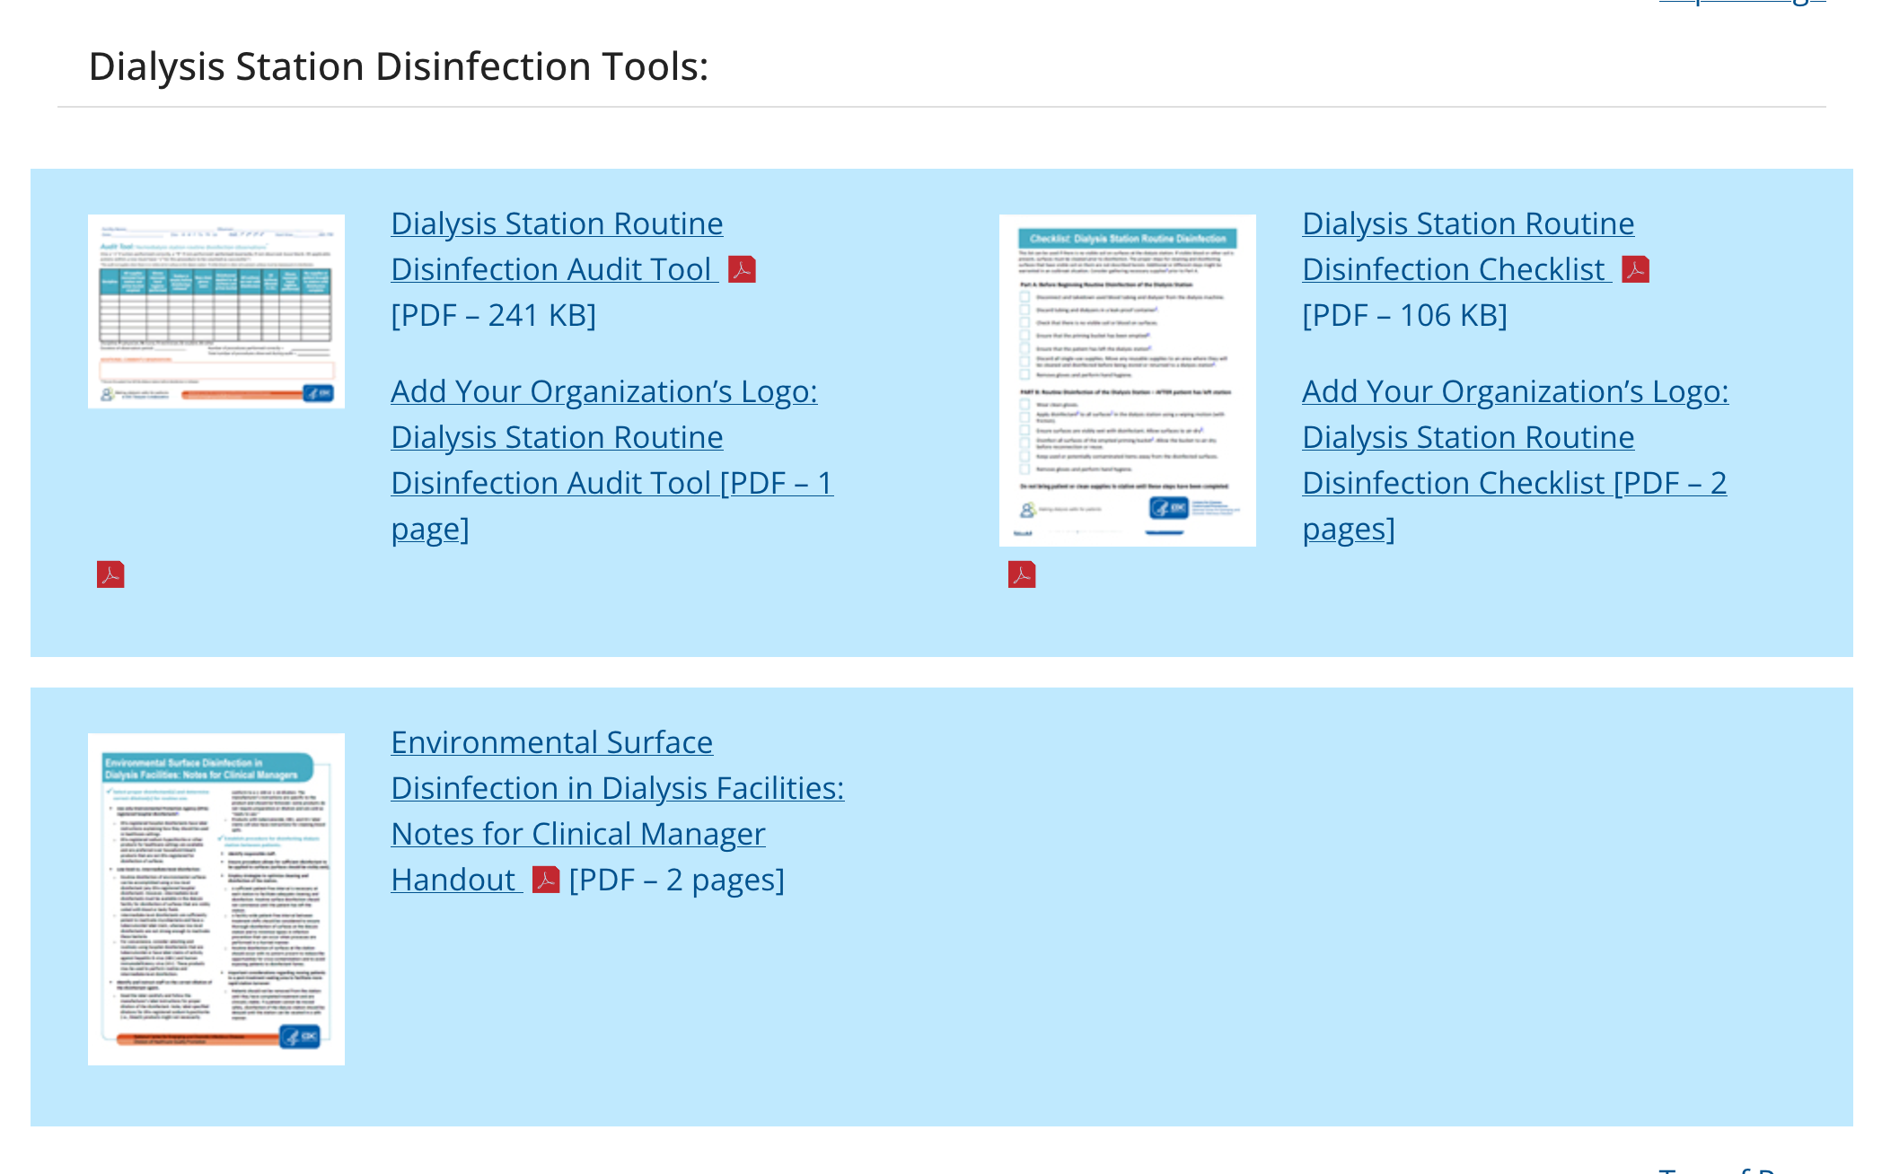
https://www.cdc.gov/dialysis/prevention-tools/audit-tools.html
Notes:
Also, here is a link to dialysis audit tools and checklists. These are just few examples of the audit tools. These are intended to promote CDC-recommended practices for infection prevention in hemodialysis facilities. You can access these tools and much more using this link.

Slide 17
summary
Water treatment systems are critical to keep patients on dialysis safe
Multiple opportunities for water exposure and contamination in the dialysis setting
Adherence to recommended infection practices is critical
Know where to start and who to ask when you have questions
  REPORTS are key!
  The biomed/hemodialysis chief technician is your friend
What a “non-water expert” needs to know about water in dialysis settings

